Slide 1
Python Packages

Slide 2

Roadmap
Array Data Structure
Data Visualization
Pandas

Slide 3


Array Data Structure
“Fighting with a large army under your command is nowise different from fighting with a small one: it is merely a question of instituting signs and signals.”
–Sun Tzu on the Art of War

Slide 4
Array Data Structure
Concepts
One-dimensional arrays
Final exam grades of six students
 |  |  | Length is 6
61 | 52.5 | 71 |  | 32.5 | 68 |  | 64

Slide 5
Array Data Structure
Concepts
One-dimensional arrays
Final exam grades of six students
6 students
Length is 6
71 32.5 68
61 52.5
64
Index of the item is 2

Slide 6
Array Data Structure
Concepts
Two-dimensional arrays
Grades of three components of six students
 | 3 columns
18 |  | 26 | 71
25 |  | 15.5 | 12
24 |  | 27 | 20
10 |  | 5.5 | 17
27 |  | 26 | 15
22 |  | 21 | 21
6 rows

Slide 7
Array Data Structure
Concepts
Two-dimensional arrays
Grades of three components of six students
3 components
 | 3 columns
18 | 26 | 71
25 | 15.5 | 12
24 | 27 | 20
10 | 5.5 | 17
27 | 26 | 15
22 | 21 | 21
6 rows
Row index is 3 Column index is 2
6 students

Slide 8
Array Data Structure
Concepts
N-dimensional arrays
3 columns
18 | 26 | 71
25 | 15.5 | 12
24 | 27 | 20
10 | 5.5 | 17
27 | 26 | 15
22 | 21 | 21
Length is 6
rows 6
61 52.5
Index of the item is 2
71 32.5 68 64
One-dimensional array
Row index is 3 Column index is 2
with 6 items
Two-dimensional array
with
6 × 3 = 18 items
Dimension number | Shape | Index | Item number
1
2
N
One number Two numbers
N numbers
One index Two indexes
N indexes
Shape
Shape[0] * Shape[1]
Shape[0] *…* Shape[N]

Slide 9

Array Data Structure
NumPy arrays
Import the NumPy package
import numpy as
.<function
np
np
name>

Slide 10
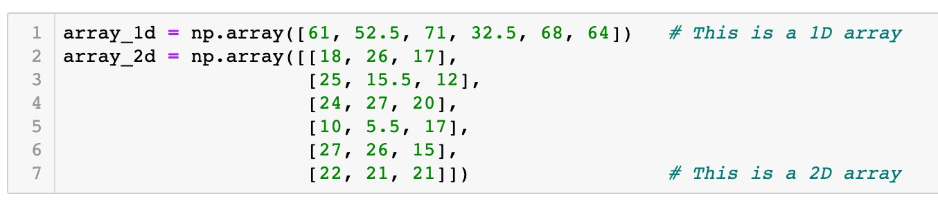
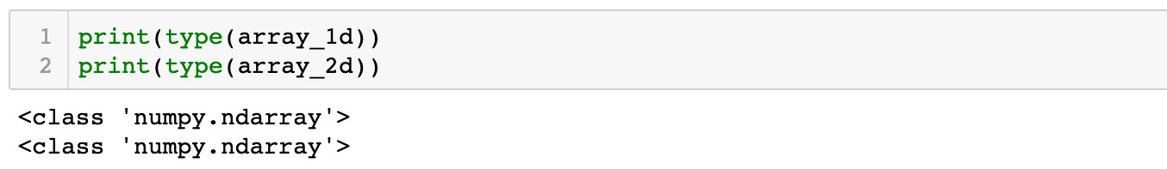

Array Data Structure
NumPy arrays
Create arrays from Python lists
Function
np.array()

Slide 11

Array Data Structure
NumPy arrays
Create arrays from Python lists
Function
np.array()
61 | 52.5 | 71 | 32.5 | 68 | 64

Slide 12
Array Data Structure
NumPy arrays
Create arrays from Python lists
Function
np.array()
18 | 26 | 71
25 | 15.5 | 12
24 | 27 | 20
10 | 5.5 | 17
27 | 26 | 15
22 | 21 | 21

Slide 13
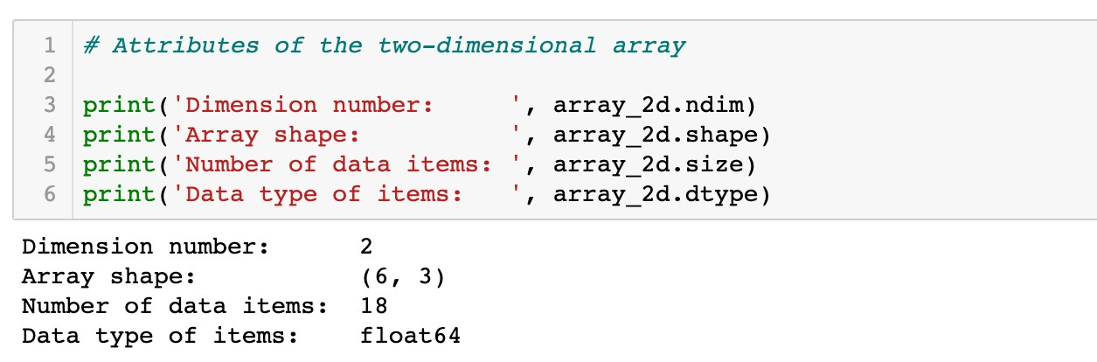
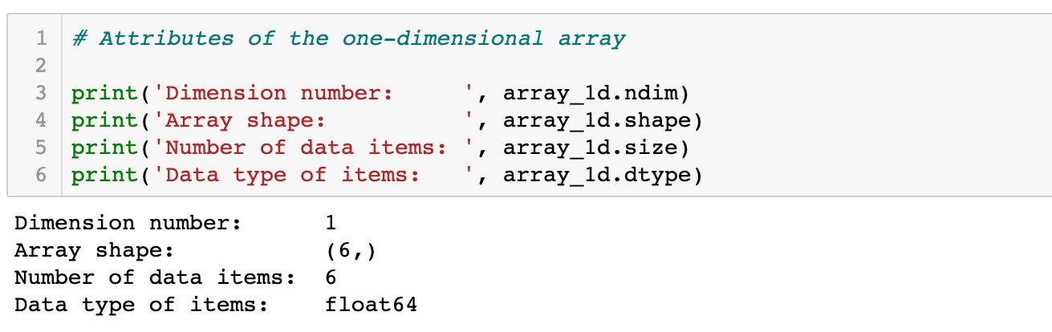
Array Data Structure
NumPy arrays
Create arrays from Python lists
Attributes of arrays

Slide 14

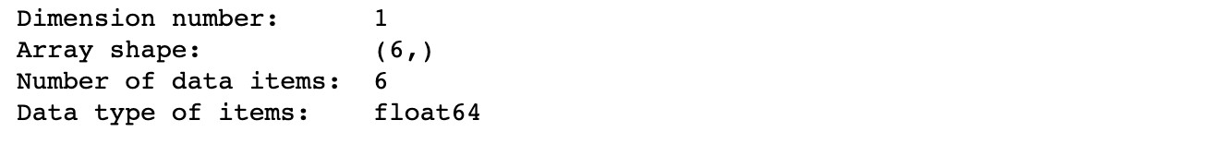
Array Data Structure
NumPy arrays
Create arrays from Python lists
Attributes of arrays
 |  | Length is 6
61 | 52.5 |  | 71 | 32.5 | 68 |  | 64
One-dimensional
array with 6 items

Slide 15
Array Data Structure
NumPy arrays
Create arrays from Python lists
Attributes of arrays
Length is 6
61 52.5
71 32.5 68 64
One-dimensional array
with 6 items
A tuple with one item

Slide 16

Array Data Structure
NumPy arrays
Create arrays from Python lists
Attributes of arrays
 |  | Length is 6
61 | 52.5 |  | 71 | 32.5 | 68 |  | 64
One-dimensional array
with 6 items

Slide 17
Array Data Structure
NumPy arrays
Create arrays from Python lists
Attributes of arrays
 |  | Length is 6
61 | 52.5 |  | 71 | 32.5 | 68 |  | 64
One-dimensional array
with 6 items
Data type: floating point numbers

Slide 18
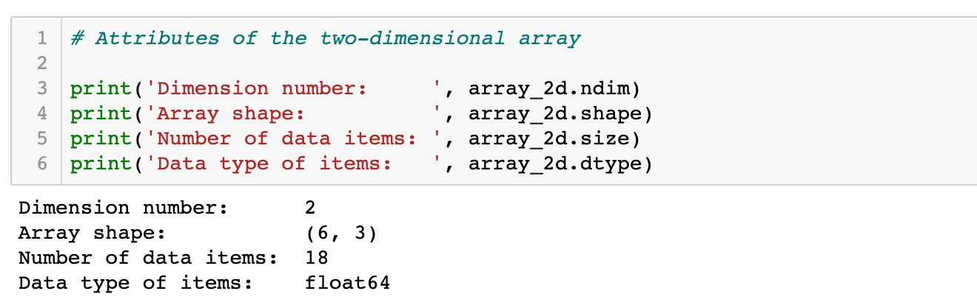
Array Data Structure
NumPy arrays
Create arrays from Python lists
Attributes of arrays

Slide 19
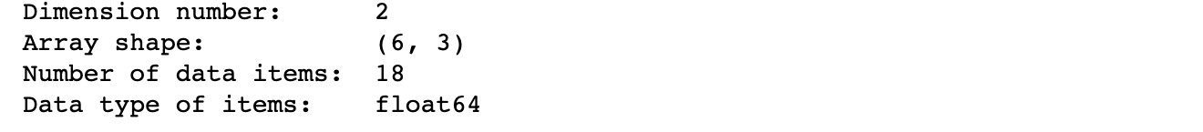
Array Data Structure
NumPy arrays
Create arrays from Python lists
Attributes of arrays
 | 3 columns
18 |  | 26 | 71
25 |  | 15.5 | 12
24 |  | 27 | 20
10 |  | 5.5 | 17
27 |  | 26 | 15
22 |  | 21 | 21
6 rows
Two-dimensional
array with 6 × 3 = 18 items

Slide 20


Array Data Structure
NumPy arrays
Create arrays from Python lists
Attributes of arrays
3 columns
18 |  | 26 | 71
25 |  | 15.5 | 12
24 |  | 27 | 20
10 |  | 5.5 | 17
27 |  | 26 | 15
22 |  | 21 | 21
ows r
6
Two-dimensional array with 6 × 3 = 18 items
axis 0

Slide 21

Array Data Structure
NumPy arrays
Create arrays from Python lists
Attributes of arrays
3 columns
18 | 26 | 71
25 | 15.5 | 12
24 | 27 | 20
10 | 5.5 | 17
27 | 26 | 15
22 | 21 | 21
ows r
6
Two-dimensional array with 6 × 3 = 18 items
axis 1

Slide 22

Array Data Structure
NumPy arrays
Create arrays from Python lists
Attributes of arrays
 | 3 columns
18 |  | 26 | 71
25 |  | 15.5 | 12
24 |  | 27 | 20
10 |  | 5.5 | 17
27 |  | 26 | 15
22 |  | 21 | 21
6 rows
Two-dimensional array
with 6 × 3 = 18 items

Slide 23
Array Data Structure
NumPy arrays
Create arrays from Python lists
Attributes of arrays
 | 3 columns
18 |  | 26 | 71
25 |  | 15.5 | 12
24 |  | 27 | 20
10 |  | 5.5 | 17
27 |  | 26 | 15
22 |  | 21 | 21
6 rows
Two-dimensional array with 6 × 3 = 18 items
Data type: floating point numbers

Slide 24
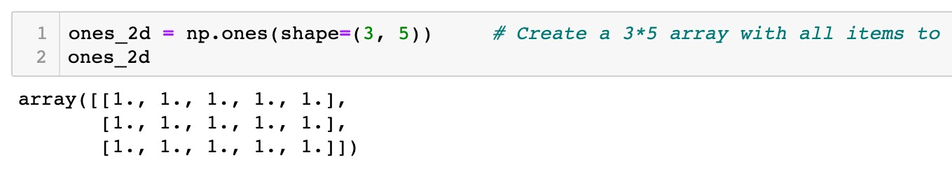
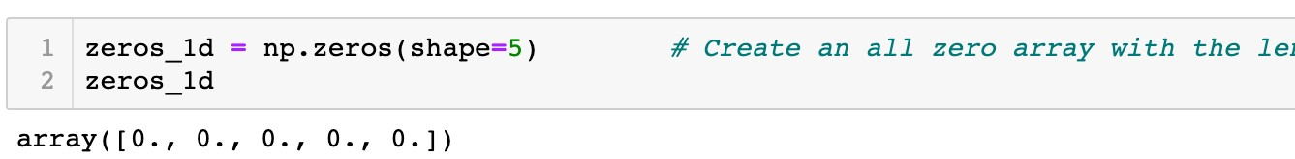
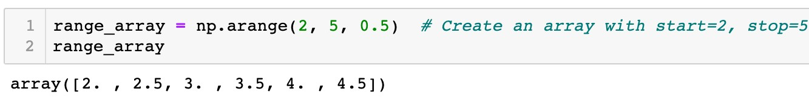
Array Data Structure
NumPy arrays
Create special arrays
A two-dimensional array: 3 rows and 5 columns
A one-dimensional array: length is 5
(start, stop, step)

Slide 25
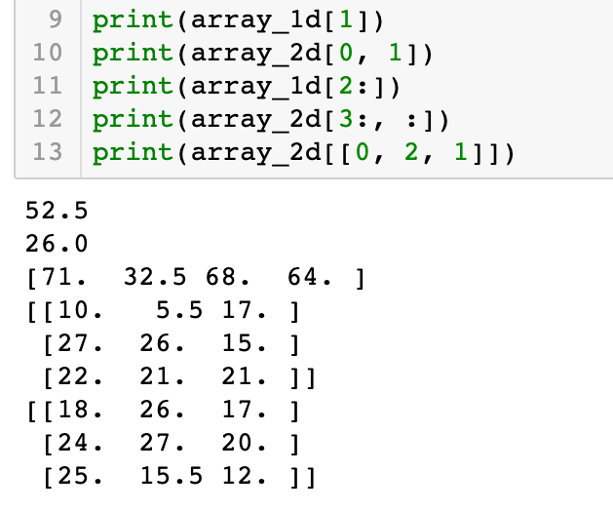
Array Data Structure
NumPy arrays
Indexing and slicing of arrays
Similar to type data
list
61 | 52.5 | 71 | 32.5 | 68 | 64
Index: 1

Slide 26
Array Data Structure
NumPy arrays
Indexing and slicing of arrays
Similar to type data
list
Row index: 0
Column index:1
18 | 26 | 71
25 | 15.5 | 12
24 | 27 | 20
10 | 5.5 | 17
27 | 26 | 15
22 | 21 | 21

Slide 27
Array Data Structure
NumPy arrays
Indexing and slicing of arrays
Similar to type data
list
61 | 52.5 | 71 | 32.5 | 68 | 64
Index: 2:6:1

Slide 28
Array Data Structure
NumPy arrays
Indexing and slicing of arrays
Similar to type data
list
18 | 26 | 71
25 | 15.5 | 12
24 | 27 | 20
10 | 5.5 | 17
27 | 26 | 15
22 | 21 | 21
Row index: 3:6:1
Column index: 0:3:1

Slide 29
Array Data Structure
NumPy arrays
Indexing and slicing of arrays
Similar to type data
list
18 | 26 | 71
25 | 15.5 | 12
24 | 27 | 20
10 | 5.5 | 17
27 | 26 | 15
22 | 21 | 21
Row index: [0, 2, 1]
Column index: 0:3:1

Slide 30
Array Data Structure
NumPy arrays
Indexing and slicing of arrays
Similar to type data
list
18 | 26 | 71
25 | 15.5 | 12
24 | 27 | 20
10 | 5.5 | 17
27 | 26 | 15
22 | 21 | 21
Row index: [0, 2, 1]
Column index: 0:3:1
Take all columns if column index is no specified

Slide 31
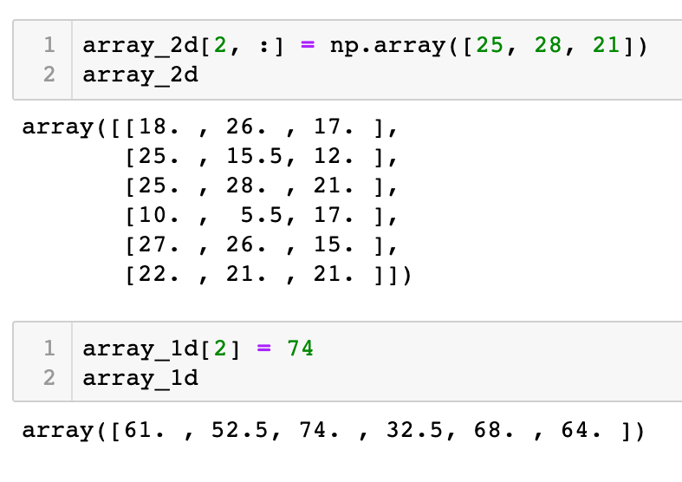
Array Data Structure
NumPy arrays
Indexing and slicing of arrays
Similar to type data
list
18 | 26 | 71
25 | 15.5 | 12
24 | 27 | 20
10 | 5.5 | 17
27 | 26 | 15
22 | 21 | 21
Items to be changed

Slide 32
Array Data Structure
NumPy arrays
Indexing and slicing of arrays
Similar to type data
list
18 | 26 | 71
25 | 15.5 | 12
25 | 28 | 21
10 | 5.5 | 17
27 | 26 | 15
22 | 21 | 21
New item values

Slide 33
Array Data Structure
NumPy arrays
Indexing and slicing of arrays
Similar to type data
list
Item to be changed
61 | 52.5 | 71 | 32.5 | 68 | 64

Slide 34
Array Data Structure
NumPy arrays
Indexing and slicing of arrays
Similar to type data
list
New item value
61 | 52.5 | 74 | 32.5 | 68 | 64

Slide 35
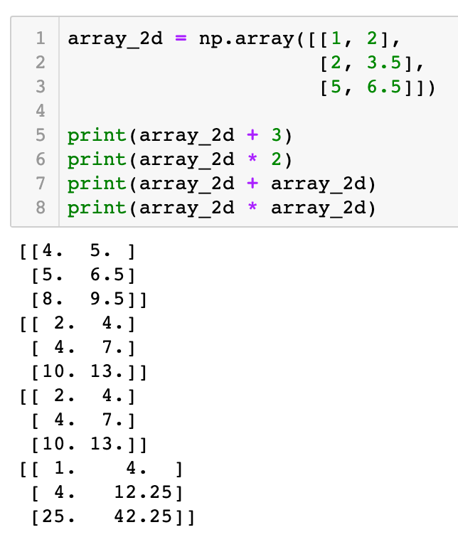
Array Data Structure
NumPy arrays
Element-wise arithmetic operations
An array and a scalar
1 | 2
2 | 3.5
5 | 6.5
4 | 5
5 | 6.5
8 | 9.5
+ 3 =
1 | 2
2 | 3.5
5 | 6.5
2 | 4
4 | 7
10 | 13
* 2 =

Slide 36
Array Data Structure
NumPy arrays
Element-wise arithmetic operations
An array and a scalar
1 | 2
2 | 3.5
5 | 6.5
1 | 2
2 | 3.5
5 | 6.5
2 | 4
4 | 7
10 | 13
+
=
1 | 2
2 | 3.5
5 | 6.5
1 | 2
2 | 3.5
5 | 6.5
1 | 4
4 | 12.25
25 | 42.25
*
=

Slide 37

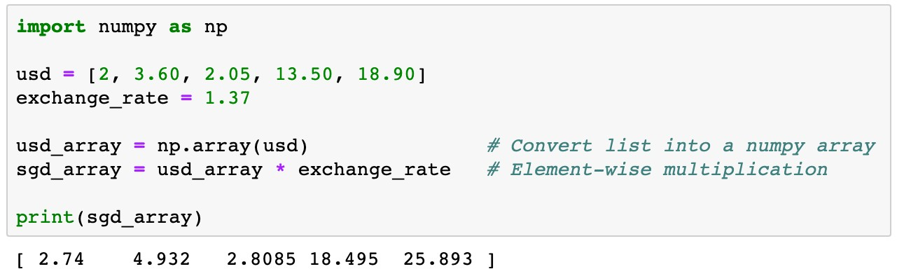
Array Data Structure
NumPy arrays
Element-wise arithmetic operations
Example 1
usd is a list of containing five money transactions in US dollars. Transfer each transaction into Singapore dollars.

Slide 38

Array Data Structure
NumPy arrays
Element-wise arithmetic operations
2 | 3.60 | 2.05 | 13.50 | 18.90

Slide 39

Array Data Structure
NumPy arrays
Element-wise arithmetic operations
2 | 3.60 | 2.05 | 13.50 | 18.90
* 1.37

Slide 40
Array Data Structure
NumPy arrays
Element-wise arithmetic operations
2.74 | 4.932 | 2.8085 | 18.495 | 25.893

Slide 41
Array Data Structure
NumPy arrays
Element-wise arithmetic operations
More concise
Easier to read
Faster to execute than loops

Slide 42
Roadmap
Array Data Structure
Data Visualization
Pandas

Slide 43
Data Visualization

Slide 44

Data Visualization
Data Visualization Packages
Import the Matplotlib package
import
matplotlib.pyplot as
plt
plt
.<function name>
Other package
Plotly
Seaborn

Slide 45

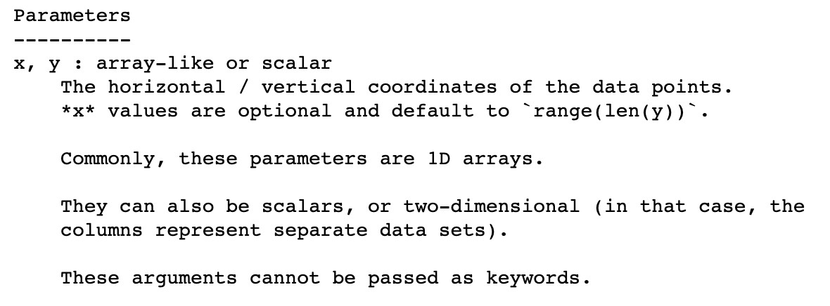
Data Visualization
Functions
Line plot
plot()
,
scatter()
, and
bar()
✓
help()
information of
plot()

Slide 46

Data Visualization
Functions
Line plot
plot()
,
scatter()
, and
bar()
Example 3
Plot the graph of an exponential function y = exp(x), where
x = 0,1,2,3,4,5.

Slide 47
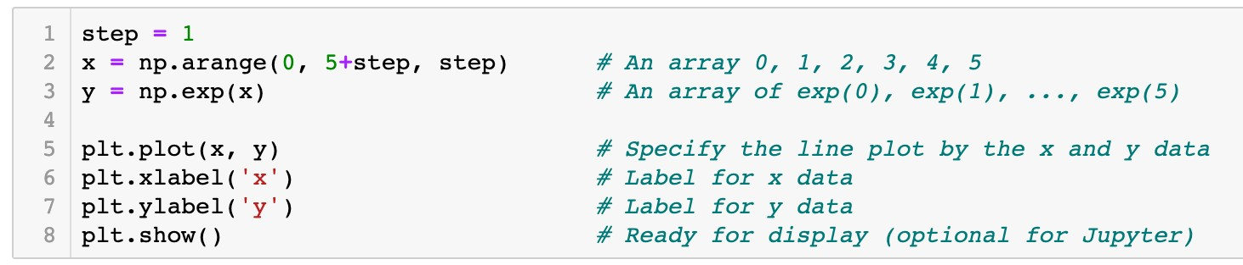
Data Visualization
Functions
Line plot
plot()
,
scatter()
, and
bar()
Example 3
Plot the graph of an exponential function y = exp(x), where
x = 0,1,2,3,4,5.

Slide 48
Data Visualization
Functions
Line plot
plot()
,
scatter()
, and
bar()
x
0 1 2 3 4 5

Slide 49
Data Visualization
Functions
Line plot
plot()
,
scatter()
, and
bar()
x
0 1 2 3 4 5
y
exp(0) exp(1) exp(2) exp(3) exp(4) exp(5)

Slide 50

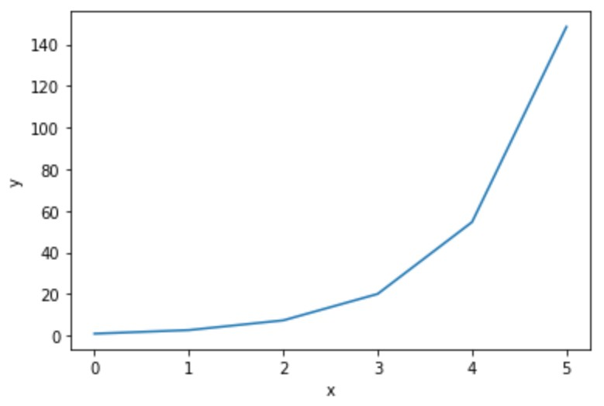
Data Visualization
Functions
Line plot
plot()
,
scatter()
, and
bar()
x
0 1 2 3 4 5
y
exp(0) exp(1) exp(2) exp(3) exp(4) exp(5)
(x[0], y[0])

Slide 51
Data Visualization
Functions
Line plot
plot()
,
scatter()
, and
bar()
x
0 1 2 3 4 5
y
exp(0) exp(1) exp(2) exp(3) exp(4) exp(5)
(x[1], y[1])

Slide 52
Data Visualization
Functions
Line plot
plot()
,
scatter()
, and
bar()
x
0 1 2 3 4 5
y
exp(0) exp(1) exp(2) exp(3) exp(4) exp(5)
(x[2], y[2])

Slide 53
Data Visualization
Functions
Line plot
plot()
,
scatter()
, and
bar()
x
0 1 2 3 4 5
y
exp(0) exp(1) exp(2) exp(3) exp(4) exp(5)
(x[5], y[5])

Slide 54
Data Visualization
Functions
Line plot
plot()
,
scatter()
, and
bar()
x
0 1 2 3 4 5
y
exp(0) exp(1) exp(2) exp(3) exp(4) exp(5)

Slide 55
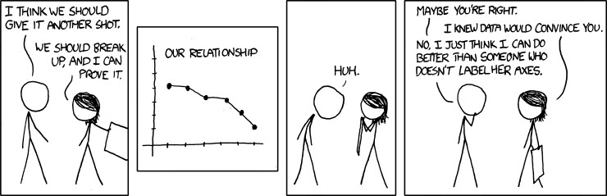
Data Visualization
Functions
plot()
,
scatter()
, and
bar()

Slide 56
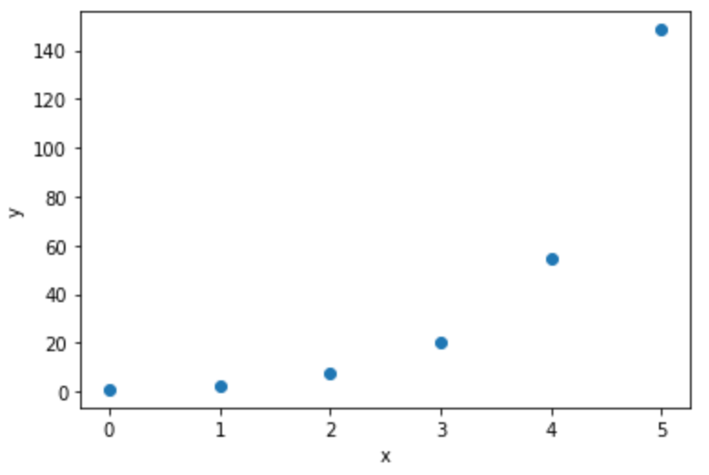
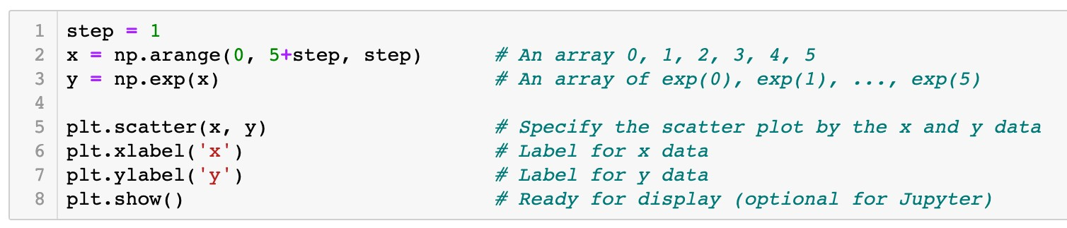
Data Visualization
Functions
plot()
,
scatter()
, and
bar()
Scatter plot
x
0 1 2 3 4 5
y
exp(0) exp(1) exp(2) exp(3) exp(4) exp(5)

Slide 57
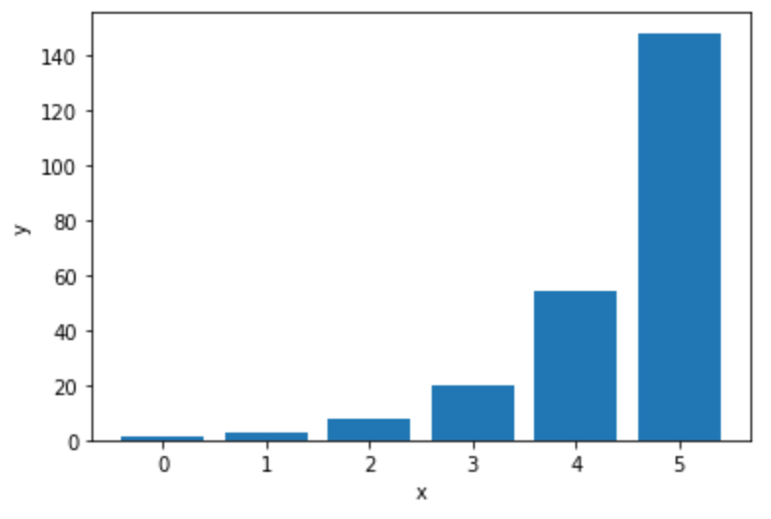
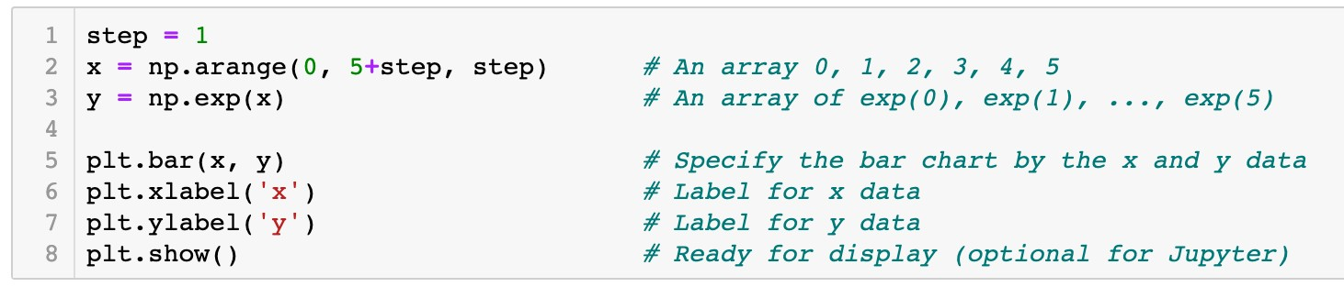
Data Visualization
Functions
plot()
,
scatter()
, and
bar()
Bar graph
x
0 1 2 3 4 5
y
exp(0) exp(1) exp(2) exp(3) exp(4) exp(5)

Slide 58

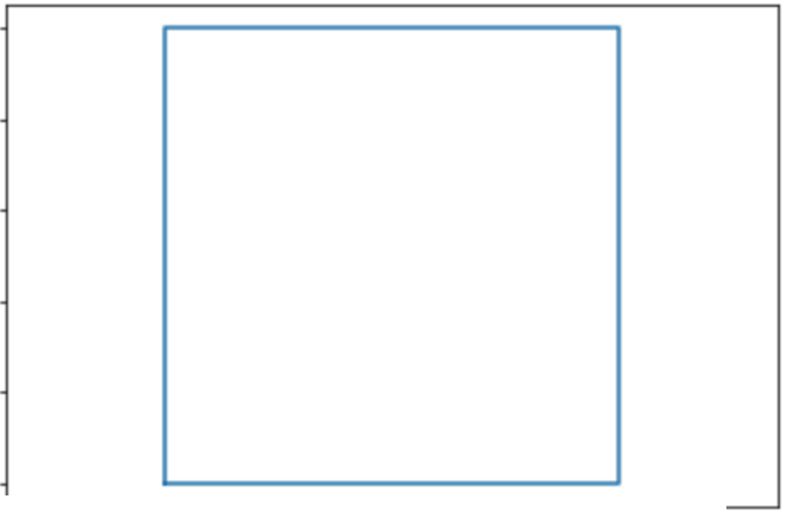
Data Visualization
Question
Which of the following code plots a square as the graph shows?
A.plt.plot([O , 0, 1, 1, O ],
[ 0 '
1, 0, 1, O ])
B. plt.plot([O , 1, 1, 0, O ], _{[ 0 '}
0 , 1, 1, 0 ] )
c. plt.plot([O , 1, 1, 0]' [0'o , 1, 11 )
D. plt.plot([O , 1, 1, O ], [O , 1, 1, O 1 )
LO
08
06
04
02
00
-0 2
00
02 04
06
08 LO
L2

Slide 59
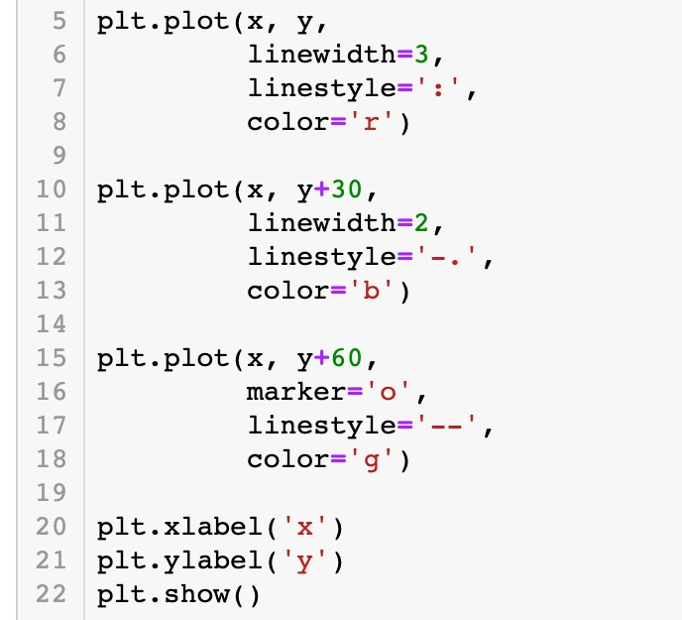
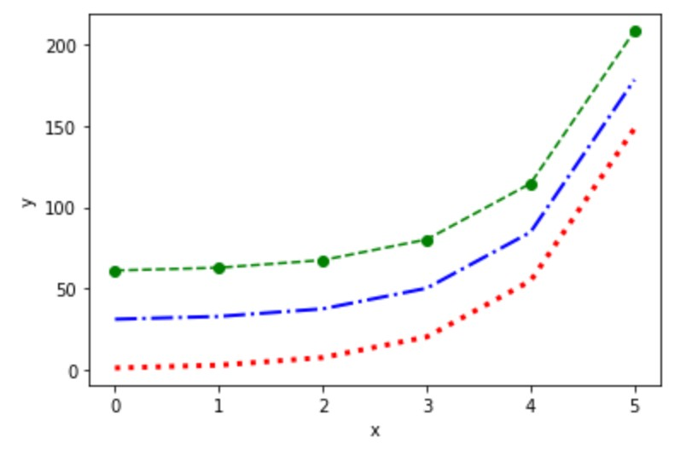
Data Visualization
Configuration of plots and figures
Specify the line plot by keyword arguments

Slide 60
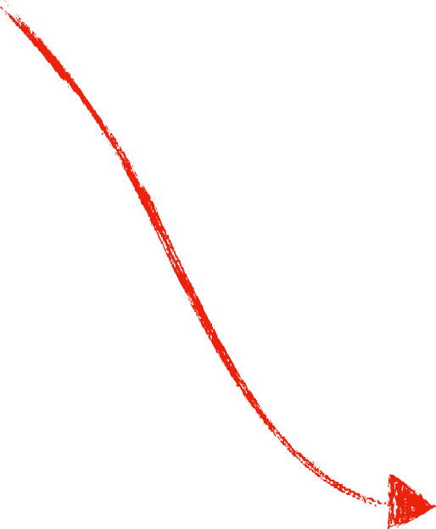
Data Visualization
Configuration of plots and figures
Specify the line plot by keyword arguments
Line width is 3 Dotted line
Line color is red

Slide 61

Data Visualization
Configuration of plots and figures
Specify the line plot by keyword arguments
Line width is 2 Dash-dotted line Line color is blue

Slide 62

Data Visualization
Configuration of plots and figures
Specify the line plot by keyword arguments
Circle marker Dashed line
Line color is green

Slide 63
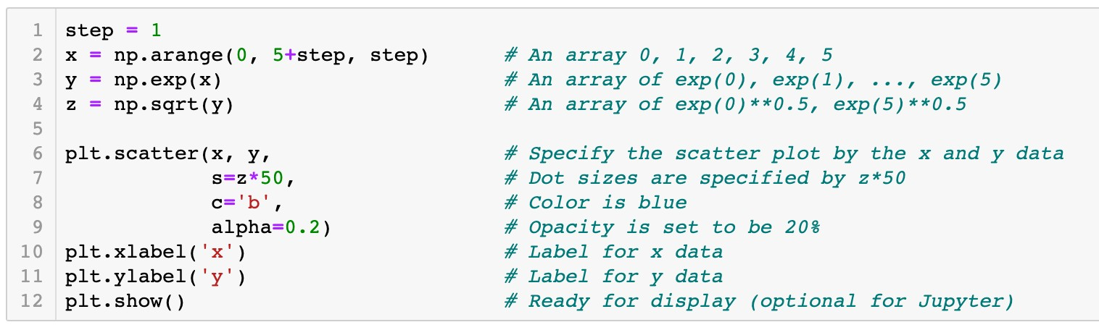
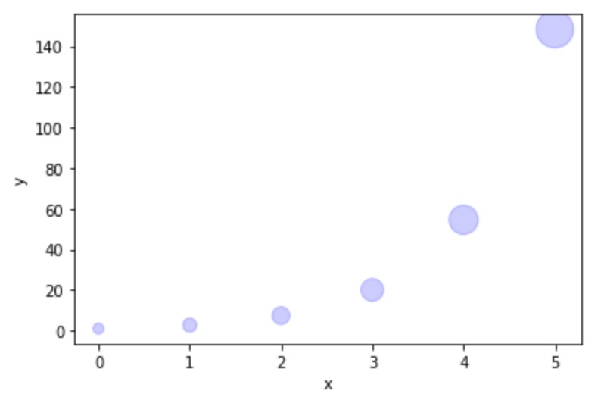
Data Visualization
Configuration of plots and figures
Specify the scatter plot by keyword arguments
Size of scatter dots

Slide 64
Data Visualization
Configuration of plots and figures
Specify the scatter plot by keyword arguments
Color of scatter dots

Slide 65
Data Visualization
Configuration of plots and figures
Specify the scatter plot by keyword arguments
Opacity of dots

Slide 66
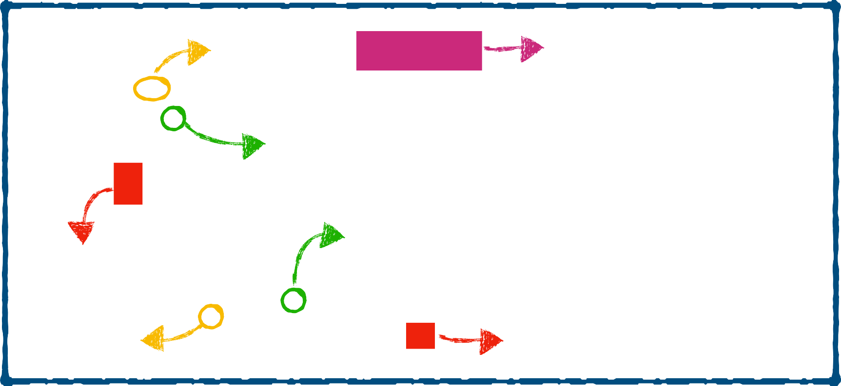
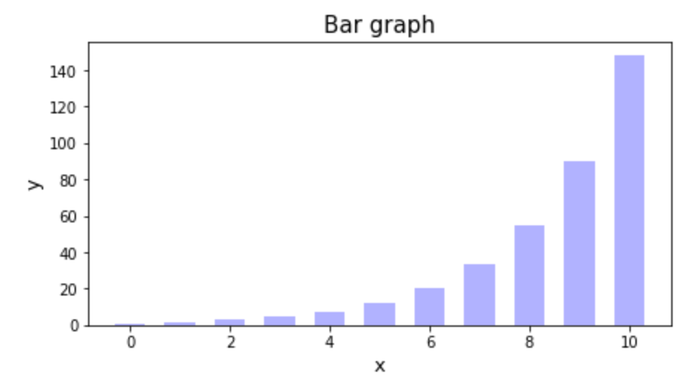
Data Visualization
Configuration of plots and figures
Components of a figure
Figure
yticklabel
title
yticks
xticks
ylabel
xticklabel
xlabel

Slide 67
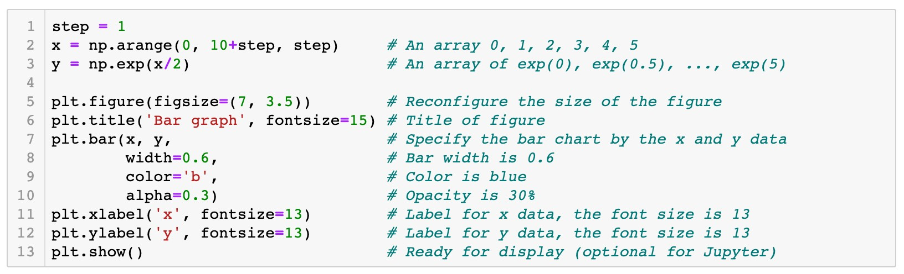

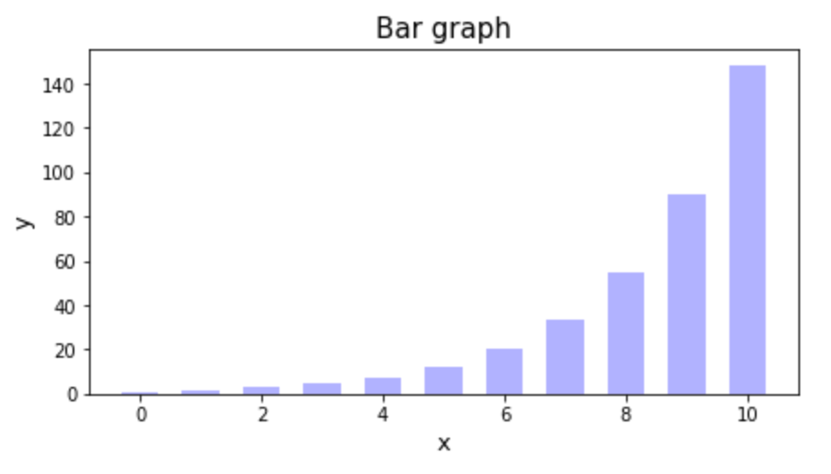
Data Visualization
Configuration of plots and figures
Attributes of a figure

Slide 68

Data Visualization
Configuration of plots and figures
Attributes of a figure
7
3.5

Slide 69
Data Visualization
Configuration of plots and figures
Attributes of a figure

Slide 70
Data Visualization
Configuration of plots and figures
Attributes of a figure

Slide 71

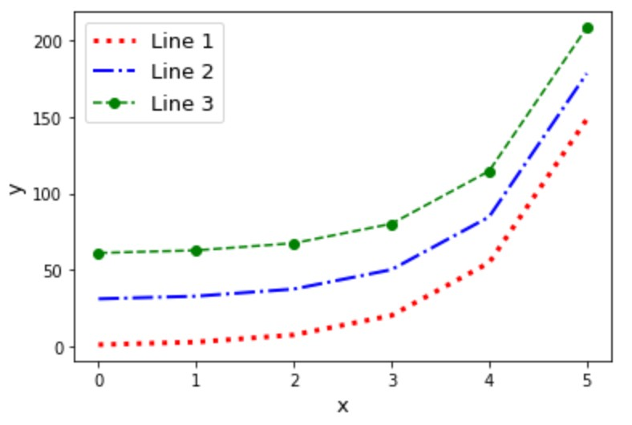

Data Visualization
Labeling plots and the function
legend()
legend

Slide 72
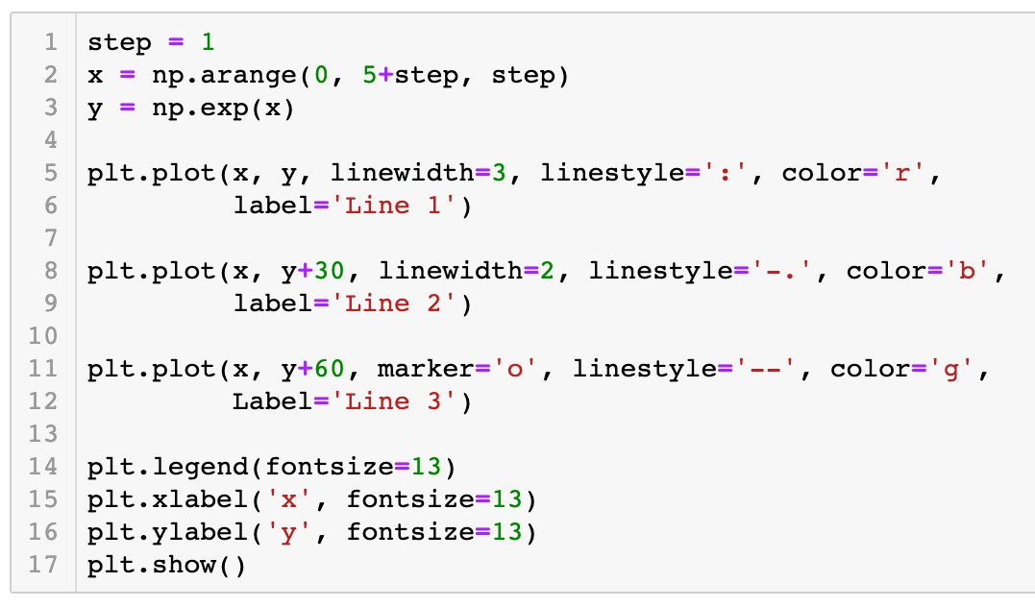


Data Visualization
Labeling plots and the function
Connection between plots and labels
legend()
legend

Slide 73


Python Packages
Packages NumPy and Matplotlib

Slide 74

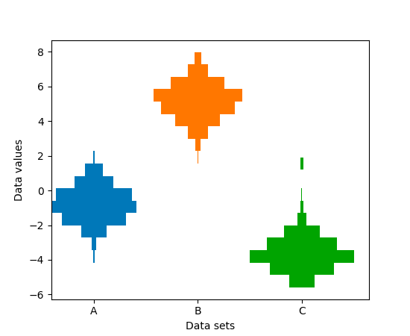

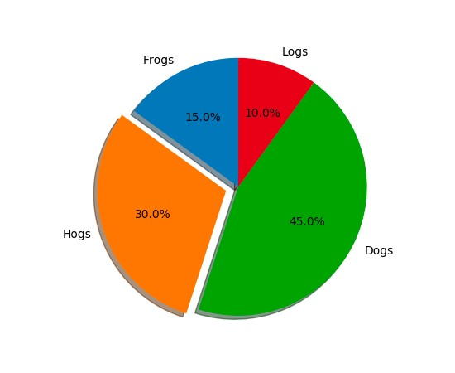

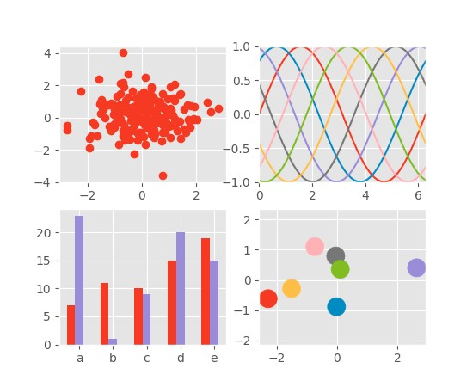
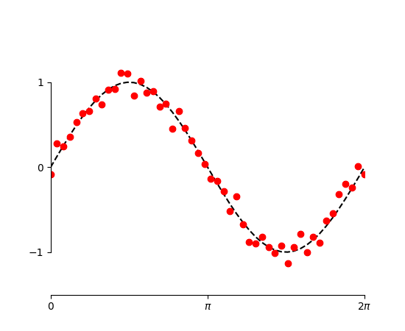
Python Packages
Packages NumPy and Matplotlib
‣
Matplotlib
thumbnail gallery: examples and demos

Slide 75
Roadmap
Array Data Structure
Data Visualization
Pandas

Slide 76
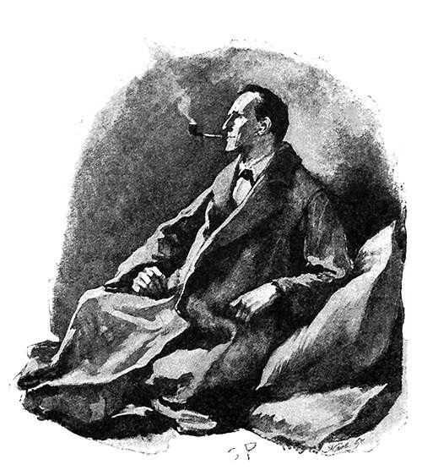
“It is a capital mistake to theorize before one has data. Insensibly one begins to twist facts to suit theories, instead of theories to suit facts.”
–Sherlock Holmes, A Scandal in Bohemia

Slide 77

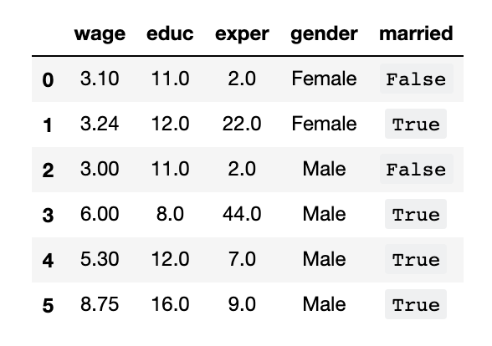
Datasets
Data representation
Example 1
The data table contains a cross-sectional dataset on a number of working individuals for the year 1976. Explore the dataset to gain some basic knowledge of the historical data.

Slide 78
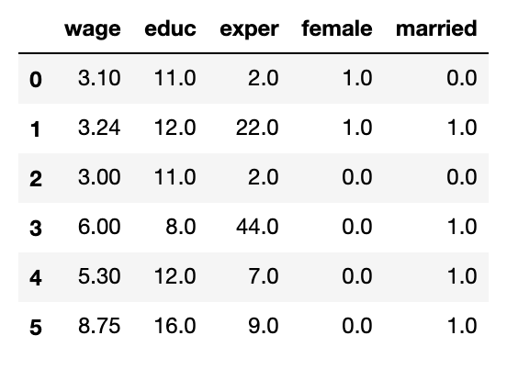
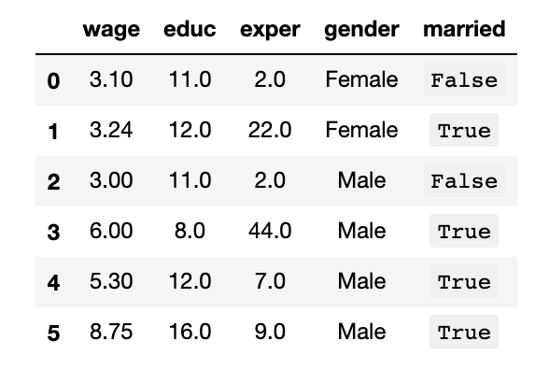
Datasets
Data representation
Variables (fields/attributes) as column labels
Years of education Average hourly
wage ($)
Years of working
experience
Gender
Marriage status

Slide 79
Datasets
Data representation
Variables (fields/attributes) as column labels
Observations (cases/records) as rows

Slide 80


Datasets
Data representation
Column index (label)
Row index (label)
Column index
Row index

Slide 81
Datasets
Types of variables
Numerical data
Categorical data
Numerical data Categorical data

Slide 82
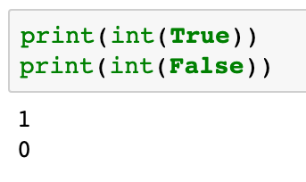
Datasets
Types of variables
Numerical (quantitative) data
Categorical (qualitative) data
Numerical data Categorical data

Slide 83
Pandas for Data Analysis
Introduction to Pandas
Labels for variables (or observations)
Heterogenous data
Possible missing values

Slide 84
Pandas for Data Analysis
Introduction to Pandas
pd
import pandas as
.<function name>
pd

Slide 85
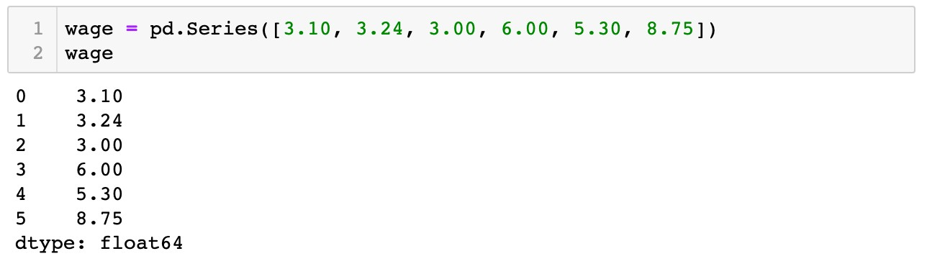

Pandas for Data Analysis
The
pandas.Series
data structure
A one-dimensional array of indexed data
Create a
pandas.Series
object

Slide 86


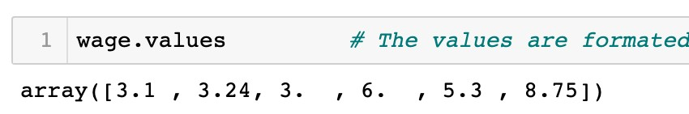
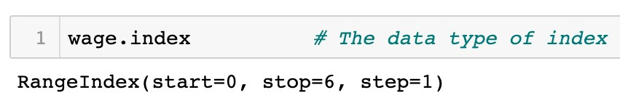
Pandas for Data Analysis
The
pandas.Series
data structure
A one-dimensional array of indexed data
Create a
pandas.Series
object

Slide 87
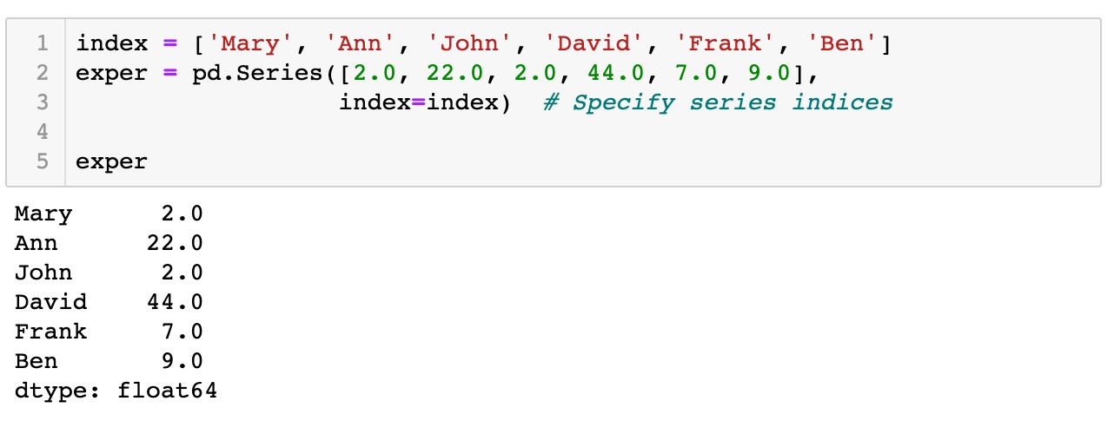

Pandas for Data Analysis
The
pandas.Series
data structure
A one-dimensional array of indexed data
Create a
pandas.Series
object
Values
Indices
exper.values
exper.index

Slide 88


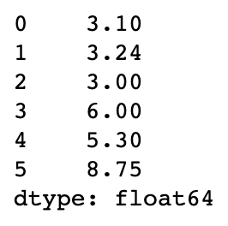
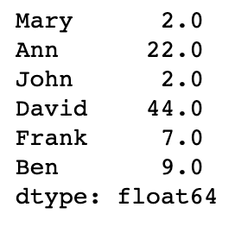


Pandas for Data Analysis
The
pandas.Series
data structure
Indexing and slicing of
pandas.Series
objects via brackets
[]
Label based indices
wage
exper
0
1
2
3
4
5
0
1
2
3
4
5
Integer-position based indices

Slide 89
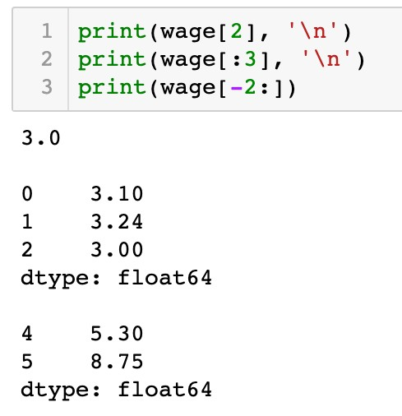
Pandas for Data Analysis
The
pandas.Series
data structure
Indexing and slicing of
pandas.Series
objects via brackets
[]
Label based indices are the same as integer-position based indices
wage
0
1
Integer-position based indices
2
3
4
5

Slide 90
Pandas for Data Analysis
The
pandas.Series
data structure
Indexing and slicing of
pandas.Series
objects via brackets
[]
Label based indices are the same as integer-position based indices
wage
0
1
2
Integer-position based indices
3
4
5

Slide 91
Pandas for Data Analysis
The
pandas.Series
data structure
Indexing and slicing of
pandas.Series
objects via brackets
[]
Label based indices are the same as integer-position based indices
wage
-6 |  | 0
-5 |  | 1
-4 |  | 2
-3 |  | 3
Integer-position based indices
-2 4
-1 5

Slide 92

Pandas for Data Analysis
The
pandas.Series
data structure
Indexing and slicing of
pandas.Series
objects via brackets
[]
Label based indices diﬀerent from integer-position based indices
exper
0
1
2
Label based indices
3
4
5

Slide 93
Pandas for Data Analysis
The
pandas.Series
data structure
Indexing and slicing of
pandas.Series
objects via brackets
[]
Label based indices diﬀerent from integer-position based indices
exper
0
1
2
Label based indices
3
4
5

Slide 94

Pandas for Data Analysis
The
pandas.Series
data structure
Indexing and slicing of
pandas.Series
objects via brackets
[]
Label based indices diﬀerent from integer-position based indices
exper
0
1
2
Label based indices
3
4
5

Slide 95
Pandas for Data Analysis
The
pandas.Series
data structure
Indexing and slicing of
pandas.Series
objects via brackets
[]
Label based indices diﬀerent from integer-position based indices
exper
0
1
2
Label based indices
3
4
5

Slide 96

Pandas for Data Analysis
The
pandas.Series
data structure
Indexing and slicing of
pandas.Series
objects via brackets
[]
Label based indices diﬀerent from integer-position based indices
exper
0
1
2
Label based indices
3
Notes
4
5
In the slicing expressions for label based indices, the
item indexed by stop are included in the selection. This is different from the list style slicing syntax we learned before.

Slide 97
Pandas for Data Analysis
The
pandas.Series
data structure
Indexing and slicing of
pandas.Series
objects via brackets
[]
Label based indices diﬀerent from integer-position based indices
exper
0
1
2
Label based indices
3
4
5

Slide 98

Pandas for Data Analysis
The
pandas.Series
data structure
Indexing and slicing of
pandas.Series
objects via brackets
[]
Label based indices diﬀerent from integer-position based indices
exper
0
1
Integer-position based indices
2
3
4
5

Slide 99
Pandas for Data Analysis
The
pandas.Series
data structure
Indexing and slicing of
pandas.Series
objects via brackets
[]
Label based indices diﬀerent from integer-position based indices
exper
0
1
Integer-position based indices
2
3
4
5

Slide 100
Pandas for Data Analysis
The
pandas.Series
data structure
Indexing and slicing of
pandas.Series
objects via brackets
[]
Label based indices diﬀerent from integer-position based indices
exper
-6
0
-5
1
Integer-position based indices
-4
2
-3 3
-2 4
-1 5

Slide 101
Pandas for Data Analysis
The
pandas.Series
data structure
Indexing and slicing of
pandas.Series
objects via brackets
[]
Label based indices diﬀerent from integer-position based indices
exper
0
1
Integer-position based indices
2
3
4
5

Slide 102








Pandas for Data Analysis
The
pandas.Series
data structure
Indexing and slicing of
pandas.Series
objects via brackets
[]
wage
exper
0
0
1
1
2
2
3
3
4
4
5
5

Slide 103



Pandas for Data Analysis
The
pandas.Series
data structure
Indexers:
loc[]
and
iloc[]
loc[]
wage
exper
0
1
2
3
4
5
0
1
2
3
4
5
iloc[]

Slide 104



Pandas for Data Analysis
The
pandas.Series
data structure
Indexers:
loc[]
and
iloc[]
exper
0
2
3
4
5
1

Slide 105


Pandas for Data Analysis
The
pandas.Series
data structure
Indexers:
loc[]
and
iloc[]
exper
0
1
2
3
4
5

Slide 106

Pandas for Data Analysis
The
pandas.Series
data structure
Indexers:
loc[]
and
iloc[]
exper
0
1
3
4
5
2

Slide 107


Pandas for Data Analysis
The
pandas.Series
data structure
Indexers:
loc[]
and
iloc[]
exper
0
1
3
5
2
4

Slide 108


Pandas for Data Analysis
The
pandas.Series
data structure
Indexers:
loc[]
and
iloc[]
wage
0
0
1
1
stop
2
is included
2
3
3
4
5
4
5

Slide 109

Pandas for Data Analysis
The
pandas.Series
data structure
Indexers:
loc[]
and
iloc[]
wage
0
1
0
1
2
stop
2
is excluded
3
4
5
3
4
5

Slide 110
Pandas for Data Analysis
The
pandas.Series
data structure
Indexers:
loc[]
and
iloc[]
Label based indices are expressed by index included in the selection
loc[]
, with the
stop
Integer-position based indices are expressed by
iloc[]
with the
stop
index excluded from the selection
Coding Style
One guiding principle of Python code is that "explicit is better than implicit." The explicit nature of and make them very useful in maintaining clean and readable code; especially in the case of integer indexes.
loc[]
iloc[]

Slide 111


Pandas for Data Analysis
The
Create a
pandas.DataFrame
data structure
pandas.DataFrame
object

Slide 112

Pandas for Data Analysis
The
Create a
pandas.DataFrame
data structure
pandas.DataFrame
object
Constructor

Slide 113


Pandas for Data Analysis
The
pandas.DataFrame
data structure
Create a
pandas.DataFrame
object
Column index
data_frame.columns

Slide 114


Pandas for Data Analysis
The
Create a
pandas.DataFrame
data structure
pandas.DataFrame
object
Row index
data_frame.index

Slide 115
Pandas for Data Analysis
The
Create a
pandas.DataFrame
data structure
pandas.DataFrame
object

Slide 116



Pandas for Data Analysis
The
Create a
pandas.DataFrame
data structure
pandas.DataFrame
object

Slide 117
Pandas for Data Analysis
The
pandas.DataFrame
data structure
Accessing columns and rows via brackets
[]
Columns: a single column index or a list of column indices

Slide 118


Pandas for Data Analysis
The
pandas.DataFrame
data structure
Accessing columns and rows via brackets
[]
Columns:
a single column index
or a list of column indices

Slide 119

Pandas for Data Analysis
The
pandas.DataFrame
data structure
Accessing columns and rows via brackets
[]
Columns: a single column index or
a list of column indices

Slide 120
Pandas for Data Analysis
The
pandas.DataFrame
data structure
Accessing columns and rows via brackets
[]
Rows: a slicing expression of the label based or integer-position based indices

Slide 121


Pandas for Data Analysis
The
pandas.DataFrame
data structure
Accessing columns and rows via brackets
[]
Rows:
a slicing expression
of the label based or integer-position
2

Slide 122

Pandas for Data Analysis
The
pandas.DataFrame
data structure
Accessing columns and rows via brackets
[]
Rows:
a slicing expression
of the label based or integer-position

Slide 123








Pandas for Data Analysis
The
pandas.DataFrame
data structure
Accessing columns and rows via brackets
Question
[]
Given a data table, how to access the highlighted subset? A.
B.
C.
D.
E.
F.

Slide 124
Pandas for Data Analysis
The
pandas.DataFrame
data structure
Accessing columns and rows via brackets
[]
Columns: a single column index or a list of column indices
Rows: of the label based or integer-position based indices
a slicing expression

Slide 125

Pandas for Data Analysis
The
pandas.DataFrame
data structure
Indexers:
loc[]
and
iloc[]

Slide 126





Pandas for Data Analysis
The
pandas.DataFrame
data structure
Indexers:
loc[]
and
iloc[]
Integer-position based column indices
Integer-position based row indices
1 2
0 3
4
0
1
2
3
4
5

Slide 127



Pandas for Data Analysis
The
pandas.DataFrame
data structure
Indexers:
loc[]
and
iloc[]
Integer-position based column indices
Integer-position based row indices
1 2
0 3
4
0
1
2
3
4
5

Slide 128

Pandas for Data Analysis
The
pandas.DataFrame
data structure
Indexers:
loc[]
and
iloc[]
Label based column indices
Label based row indices

Slide 129


Pandas for Data Analysis
The
pandas.DataFrame
data structure
Indexers:
loc[]
and
iloc[]
Label based column indices
Label based row indices
Notes
In the slicing expressions for label based indices (loc[]), the item indexed by stop are included in the selection. This is different from the list style slicing syntax we learned before.

Slide 130


Pandas for Data Analysis
The
pandas.DataFrame
data structure
Indexers:
loc[]
and
iloc[]
Access all rows or columns via
:
0
1
2
3
4
All rows
Column indices

Slide 131


Pandas for Data Analysis
The
pandas.DataFrame
data structure
Indexers:
loc[]
and
iloc[]
Access all rows or columns via
:
All columns
All indices

Slide 132


Pandas for Data Analysis
The
pandas.DataFrame
data structure
Indexers:
loc[]
and
iloc[]
Access all rows or columns via
:
All columns as default
All indices

Slide 133

Pandas for Data Analysis
The
Indexers:
pandas.DataFrame
data structure
loc[]
and
iloc[]
Data types of indices

Slide 134

Pandas for Data Analysis
The
Indexers:
pandas.DataFrame
data structure
loc[]
and
iloc[]
Data types of indices
0
1
2
3
4

Slide 135

Pandas for Data Analysis
The
Indexers:
pandas.DataFrame
data structure
loc[]
and
iloc[]
Data types of indices
0
1
2
3
4

Slide 136
Pandas for Data Analysis
The
pandas.DataFrame
data structure
Modify a subset of a
pandas.DataFrame
object
Similar to modifying a part of a built-in compound data object (list/dictionary)

Slide 137






Pandas for Data Analysis
The
Modify a subset of a
data structure
object
pandas.DataFrame
pandas.DataFrame

Slide 138





Pandas for Data Analysis
The
pandas.DataFrame
data structure
Modify a subset of a
pandas.DataFrame
object
0
1 2
3
4
0
1 2
3
4
0
0
1
1
2
2
3
3
4
4
5
5

Slide 139




Pandas for Data Analysis
The
pandas.DataFrame
data structure
Modify a subset of a
pandas.DataFrame
object
New label added as a new column

Slide 140
Pandas for Data Analysis
The
Boolean
pandas.DataFrame
data structure
and boolean indexing
pandas.Series
A subset for female workers?

Slide 141

Pandas for Data Analysis
The
Boolean
pandas.DataFrame
data structure
and boolean indexing
pandas.Series

Slide 142

Pandas for Data Analysis
The
Boolean
pandas.DataFrame
data structure
and boolean indexing
pandas.Series
is_female
=='Female'
=='Female'
=='Female'
=='Female'
=='Female'
=='Female'
TRUE TRUE FALSE FALSE FALSE FALSE

Slide 143


Pandas for Data Analysis
The
Boolean
pandas.DataFrame
data structure
and boolean indexing
pandas.Series
is_high_wage
> 4
> 4
> 4
> | 4
> | 4
> | 4
FALSE FALSE FALSE TRUE TRUE TRUE

Slide 144


Pandas for Data Analysis
The
Boolean
pandas.DataFrame
data structure
and boolean indexing
pandas.Series
is_wife
TRUE TRUE TRUE FALSE FALSE FALSE
FALSE TRUE FALSE TRUE TRUE TRUE
FALSE TRUE FALSE FALSE FALSE FALSE
&

Slide 145

Pandas for Data Analysis
The
Boolean
pandas.DataFrame
data structure
and boolean indexing
pandas.Series
is_female
TRUE TRUE
FALSE
FALSE
FALSE
FALSE

Slide 146

Pandas for Data Analysis
The
Boolean
pandas.DataFrame
data structure
and boolean indexing
pandas.Series

Slide 147



Pandas for Data Analysis
The
Boolean
pandas.DataFrame
data structure
and boolean indexing
pandas.Series
is_wife
FALSE
TRUE
FALSE
FALSE
FALSE
FALSE

Slide 148
Pandas for Data Analysis
The
Boolean
pandas.DataFrame
data structure
and boolean indexing
pandas.Series
is_wife
FALSE
TRUE
FALSE
FALSE
FALSE
FALSE

Slide 149

Pandas for Data Analysis
The
pandas.DataFrame
data structure
Boolean
pandas.Series
and boolean indexing
Question
Please change values of the column “remarks” by yourself according to the following rule:
The value for married male is changed to the string 'Husband';
The value for unmarried male or female is changed to the string ‘Single'.

Slide 150
Roadmap
Array Data Structure
Data Visualization
Pandas

